Slide 1
Introduction to Machine Learning

Slide 2
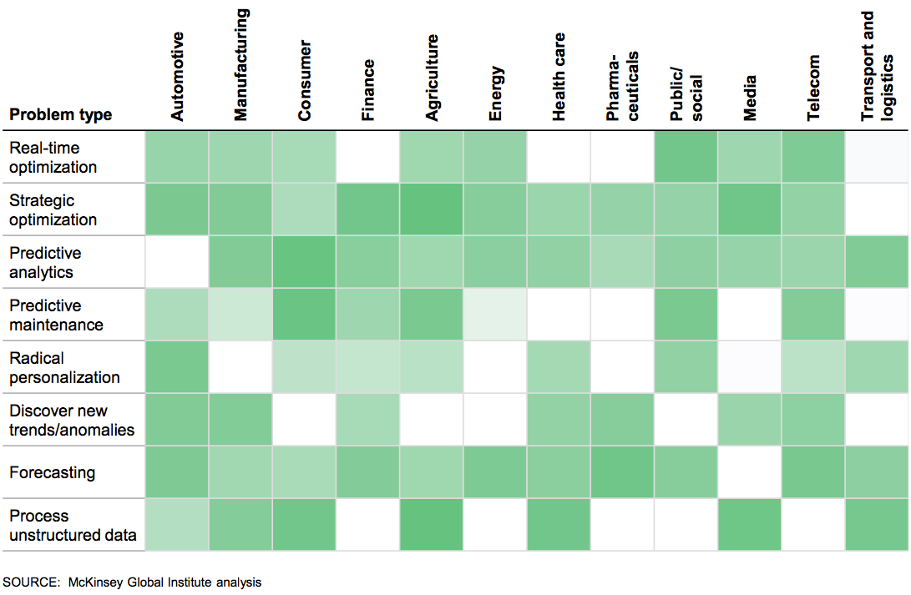
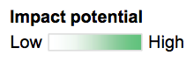
Machine Learning Impact Across Industries and Use Cases
$10s of Billions in each industry and use case
Data Science Solutions
Notes:
Data Science is having a significant impact just about every industry and there are tens of billions of opportunity in each industry and use case. Just about every industry is using predictive analytics – that is building models which can predict the future based on what occurred in the recent past. Predictive maintenance which is a variant of predictive analytics is important in a number of industries. Forecasting is present in just about every industry – and optimization is also important throughout. Even text analytics is helpful in many different industries

Slide 3
What is Machine Learning?
“Computers that learn without being explicitly programmed”
“Using algorithms to understand patterns in data”
Data
Predictions & Insight
Algorithms

Slide 4
Machine Learning in Data Science Echosystem….
Domain Knowledge
Supply Chain
CRM
Financials
Networking
Domain Expertise
Engineering
Research
Unicorn
Scripting, SQL
Python, R Scala
Data Pipelines
Big Data/ Apache Spark
Computer
Science
Machine
Learning
Math & Stats
Mathematics
Computational
Data Science Projects Require multiple Skills

Slide 5

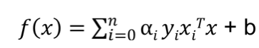
Machine Learning = Artificial Intelligence???
Data + Algorithms = Scored AI Models
Conversa- tion
Dialog
Language
Alchemy Language
Document Conversion
Discovery
Discovery News
Language Translator
Speech
Alchemy- Data News
Natural Language Classifier
Vision
Visual Recognition
Tradeoff Analytics
Natural Language
Under- standing
Text to Speech
Speech to
Text
Tone Analyzer
Retrieve and Rank
Personality Insights
Data Insights

Slide 6
Understanding AI, ML & DL Relationship…
AI
Artificial Intelligence
Machine Learning
Deep Learning

Slide 7

Methodology to create Machine Learning Model
Business understanding
Analytic approach
Feedback
Data requirements
Deployment
Data collection
Data Scientist/ Data Engineer
Statistician
Domain Expert
Evaluation
Data understanding
Modeling
Data preparation

Slide 8

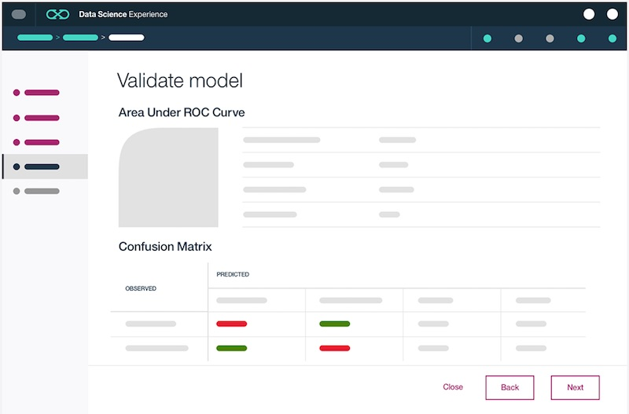


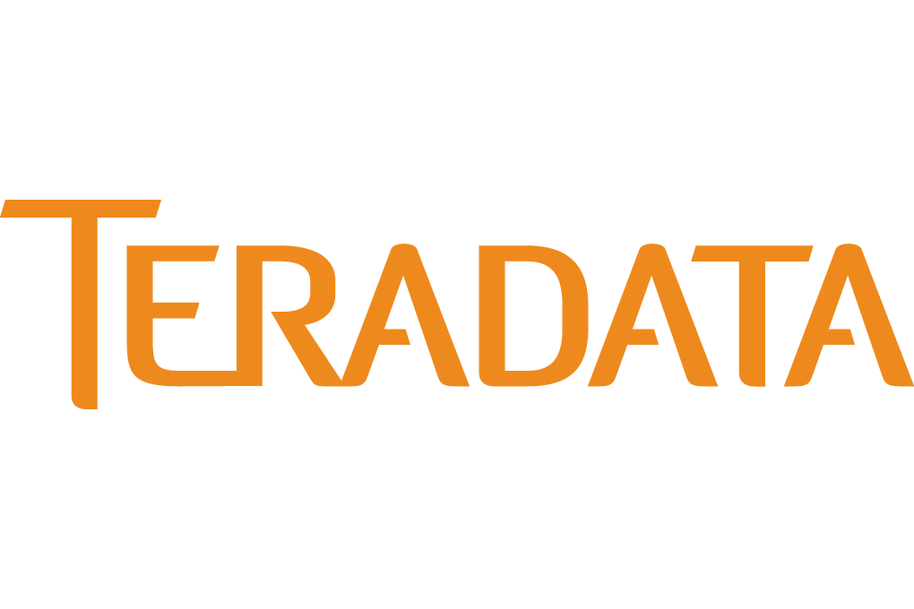

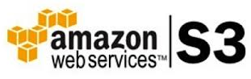
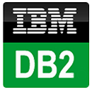

Introducing IBM Watson Machine Learning Accelerating Digital Deployments in Cloud…
Web Service
IMS
Data Access:
Easily connect to Behind-the-Firewall and Public Cloud Data
Catalogued and Governed Controls through Watson Data Platform
Creating Models:
Single UI and API for creating ML Models on various Runtimes
Auto-Modelling and Hyperparameter Optimization
Web Service:
Real-time, Streaming, and Batch Deployment
Continuous Monitoring and Feedback Loop
Intelligent Apps:
Integrate ML models with apps, websites, etc.
Continuously Improve and Adapt with Self-Learning
Notes:
Very few companies have systems in place today that can score, act, monitor, and ingest feedback. That’s where IBM Machine Learning (IBM ML) comes in. It was designed to support a continuous cycle of learning (i.e., “self-learning”). IBM ML solves a major pain point for customers by enabling them to build self-learning systems that can score, act, monitor, and ingest feedback to drive better business outcomes.
IBM Machine Learning enables you to create end-to-end pipelines with your data assets – it is the fabric that supports you in operationalizing insights from machine learning. A pipeline includes everything from connecting to your data sources, preparing your data, modelling, model evaluation, to model deployment and management.
Let’s start with the left-hand side of this chart. You can see that IBM ML can leverage the 30+ data connectors in Data Science Experience (DSX) to connect to your private cloud (on-premises) and public cloud data assets (e.g., Microsoft Azure, Amazon S3, Cloudant, etc.). These data assets can be catalogued and governed through additional Watson Data platform services. Within DSX there is both a Wizard UI and API for creating machine learning models on various runtimes (e.g. SparkML, SPSS, etc.). And to further assist Data Scientists during the modelling process, IBM ML has auto-modelling capabilities such as hyper parameter optimization.
Once the Data Scientist has built a model using IBM ML, the model can be deployed with a single click as a web service. IBM ML supports 3 forms of deployment – real-time, streaming, and batch deployment. To submit scoring requests against a deployed Watson Machine Learning model, simply ping the scoring endpoint with your authorization token. This enables IBM ML models to be integrated into websites, mobile applications, operational systems, dashboards, etc. to improve business outcomes across a variety of use cases (e.g. personalized recommendation as a mobile app, transaction risk scoring, call center content generation, etc.). The end application could be written in Java, JavaScript, Ruby, etc. or perhaps a mobile app on Android or iOS.
And once your models have been deployed, the DSX user interface (UI) provides continuous monitoring and feedback of your web service. Keep in mind that you aren’t limited to deploying your models into simple apps – you can also use the standard APIs included with IBM Machine Learning to integrate with complex operational systems. IBM ML can be the backbone of your customer’s “hard deploy” strategy for machine learning across their company (i.e., having machine learning dynamically baked into their systems).
Given the continuous monitoring and feedback loop capabilities of IBM ML, you may hear the term “self-learning” come up during customer conversations. When a customer mentions the need for a “self-learning” capability, they may be referring to:
The traditional way of building and retraining models (a Data Scientist follows all steps in building a model, including data evaluation, data preparation, model building, and model evaluation)
Auto-modeling, which is a technique where the Data Scientist does not “build a model” themselves through hand-tuning. Instead, the model is automatically built using an auto-modeling algorithm.
Automatic retraining of models. There are two main forms of “automatic retraining”:
If a model’s performance dips below a given threshold, then a model retraining process automatically kicks off
Using a streaming implementation of a machine learning algorithm (e.g. streaming K-means). These algorithm implementations automatically retrain as they receive new data points (e.g. exponential decay balancing importance of new vs. old data).

Slide 9





Entry points based on the persona
Business
Analysts
LoB Applications
COLLABORATION
Application Developers
Data
Scientists
IBM Watson Machine Learning

Slide 10
Demo

Slide 11
Add what you see fit, but please shrink this material…

Slide 12
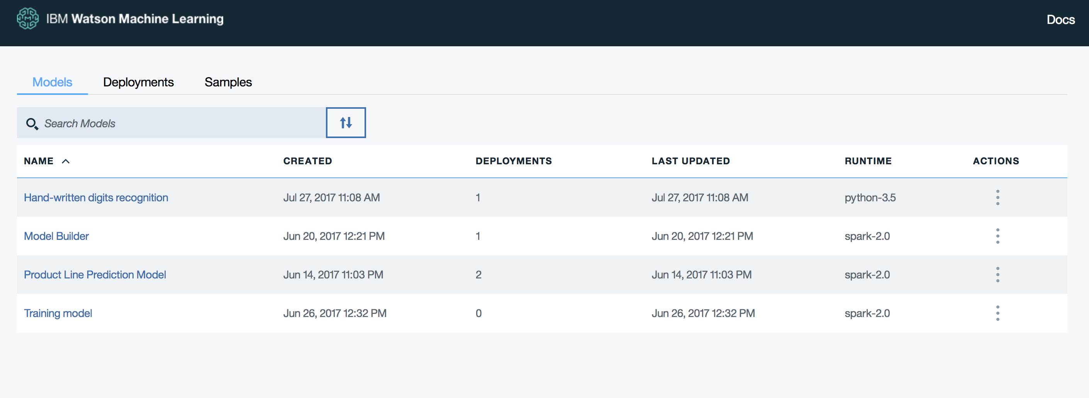
Bluemix Experience for the App Developer
Simple UI driven by REST APIs
Train models
Save models to a WML Repository
Deploy models – batch, real-time, streaming
Score data
App Developer
Bluemix dashboard

Slide 13
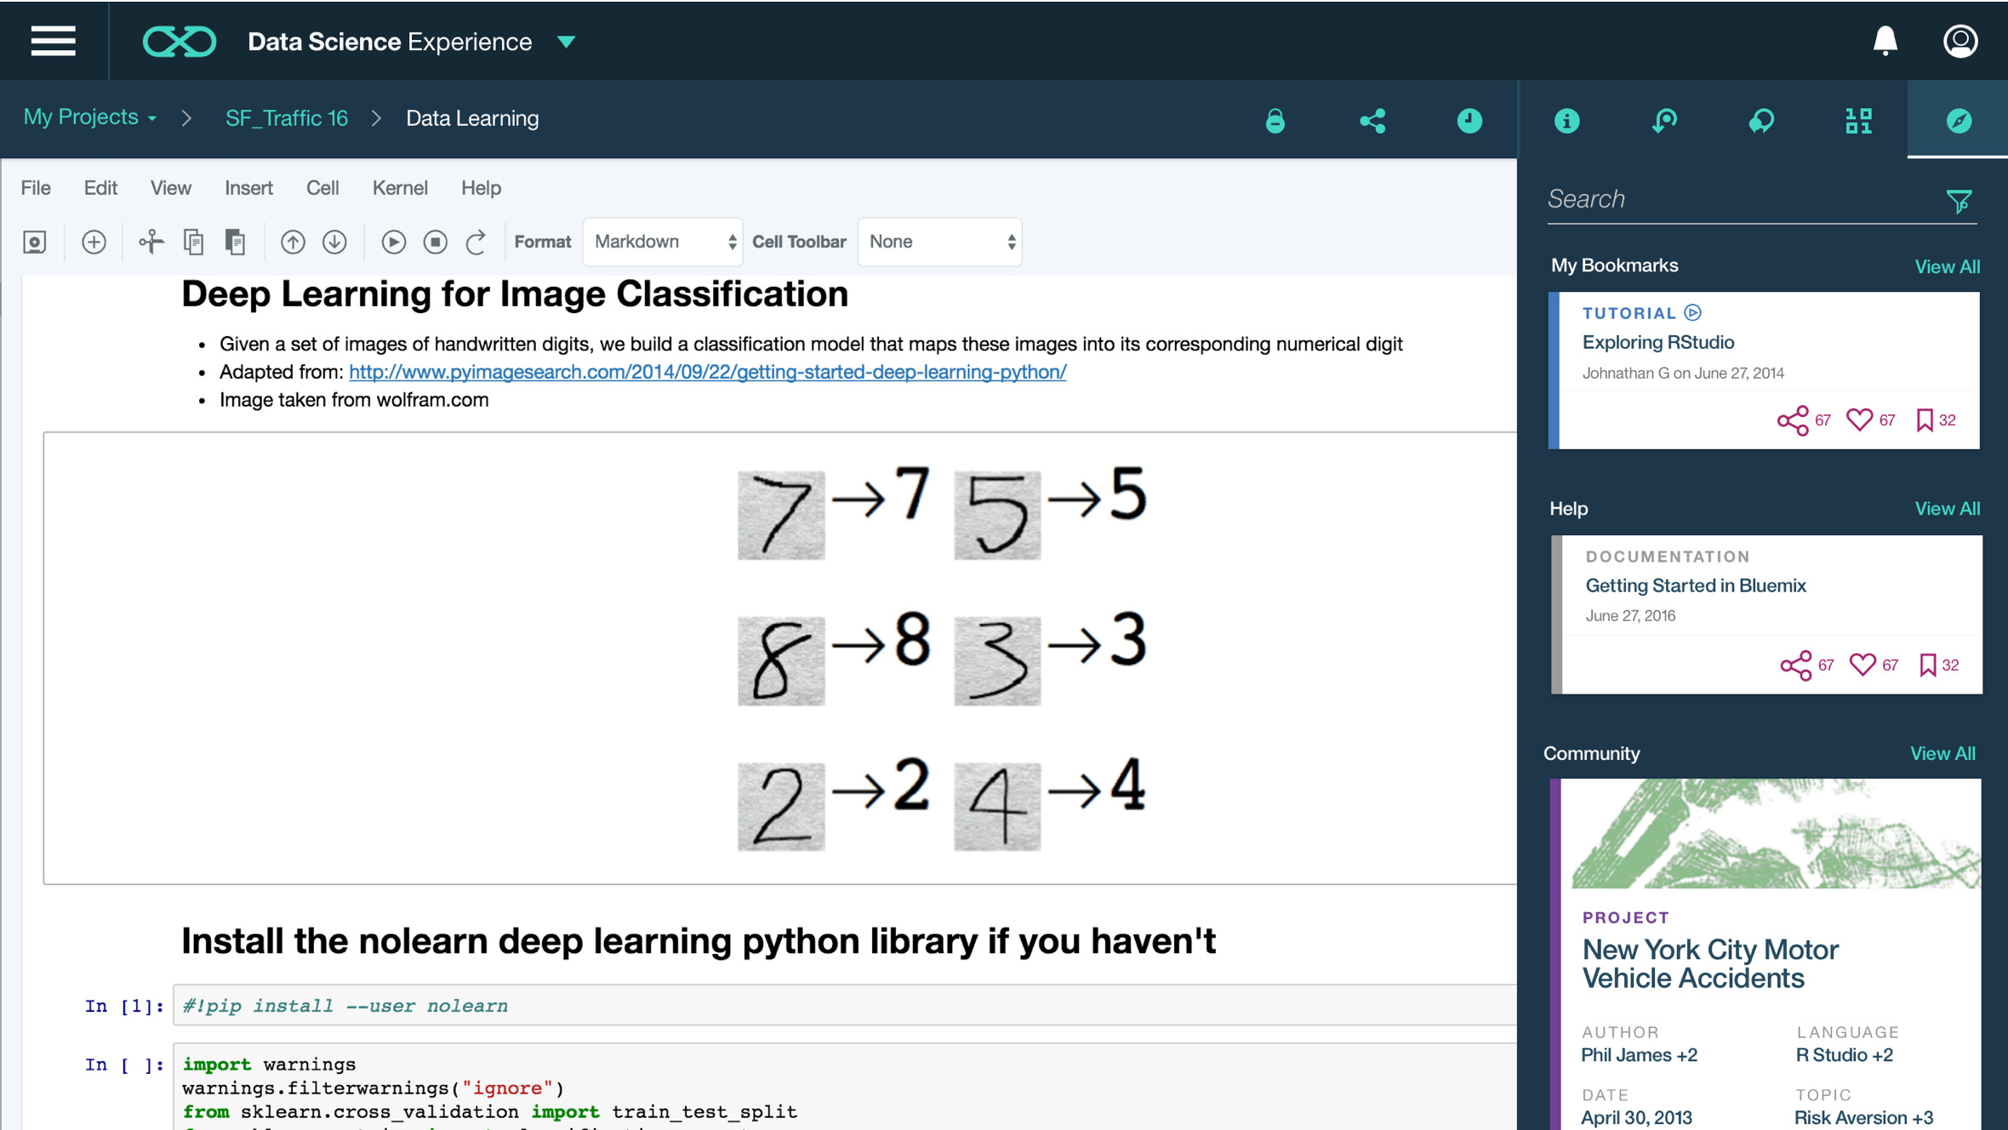
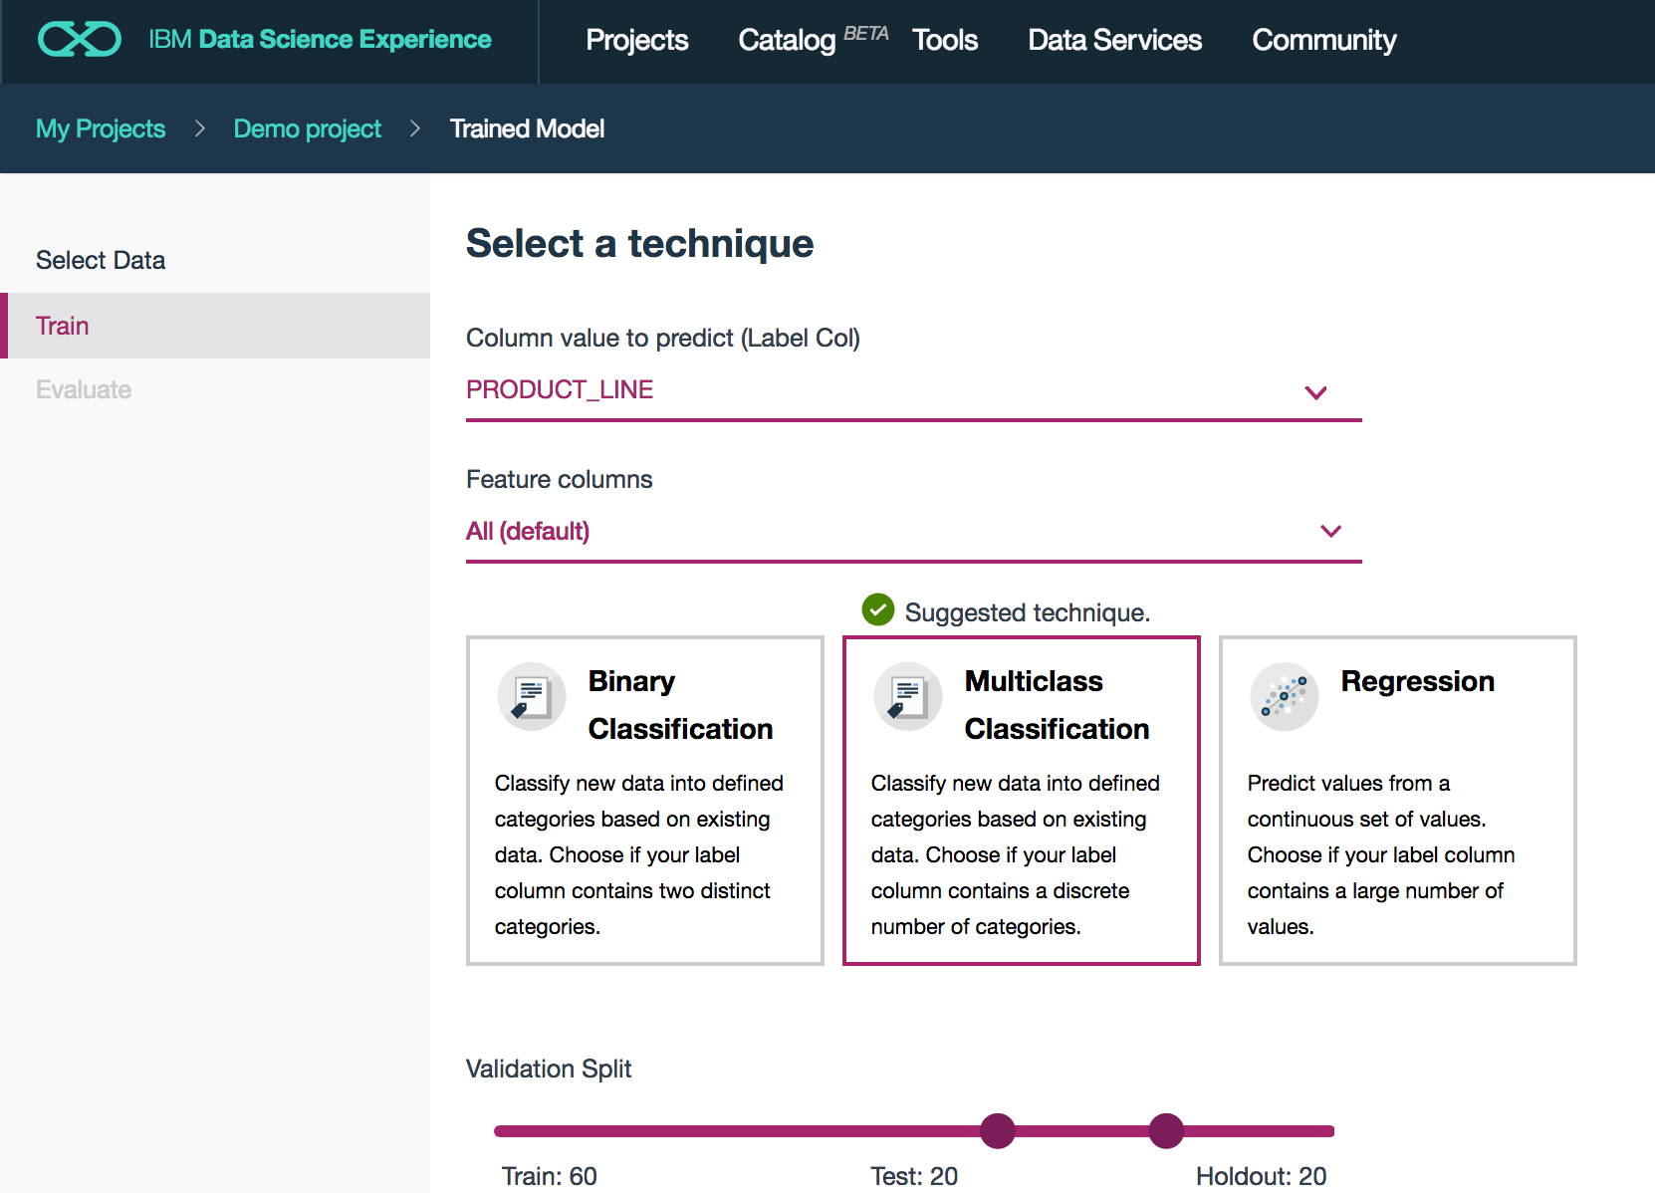
IBM Watson Machine Learning in Data Science Experience
Data Scientist
GA
APIs for Jupyter Notebooks
Model Builder GUI
Lab 2
Open Beta
Notes:
Now let’s take a look at IBM ML in Data Science Experience.
IBM Machine Learning is provisioned by default in Data Science Experience. It is our deployment fabric that enables Data Scientists to take their models from the lab to production. DSX provides a single UI for creating models, collaborating, deploying, monitoring, and integrating feedback. With a single click, Data Scientists can deploy their machine learning models as web services.
IBM ML is accessible in Data Science Experience via APIs (by coding in Notebooks), Wizard GUI (i.e., called “pipelines” in Projects), and the DSX Canvas (which is a GUI-based approach inspired by SPSS Modeler).
Note: At IBM ML GA in DSX (during 1H 2017) we expect to have both the APIs and Wizard GUI available. The DSX Canvas deployment via IBM ML will GA after the APIs and Wizard.
Also note that DSX Private Cloud will become the standard IDE for IBM ML for z/OS. This is expected to be delivered in 1H 2017.

Slide 14
WML GUI - Train multiple models at same time… System tells you best model…
Data Scientist
Open Beta

Slide 15
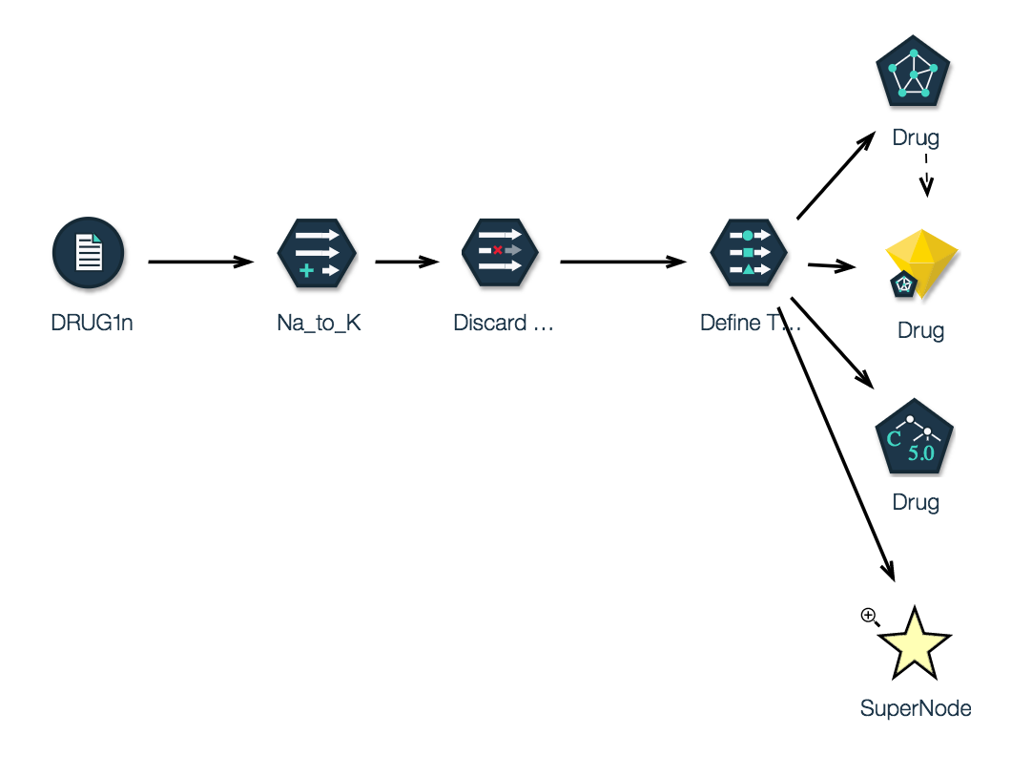
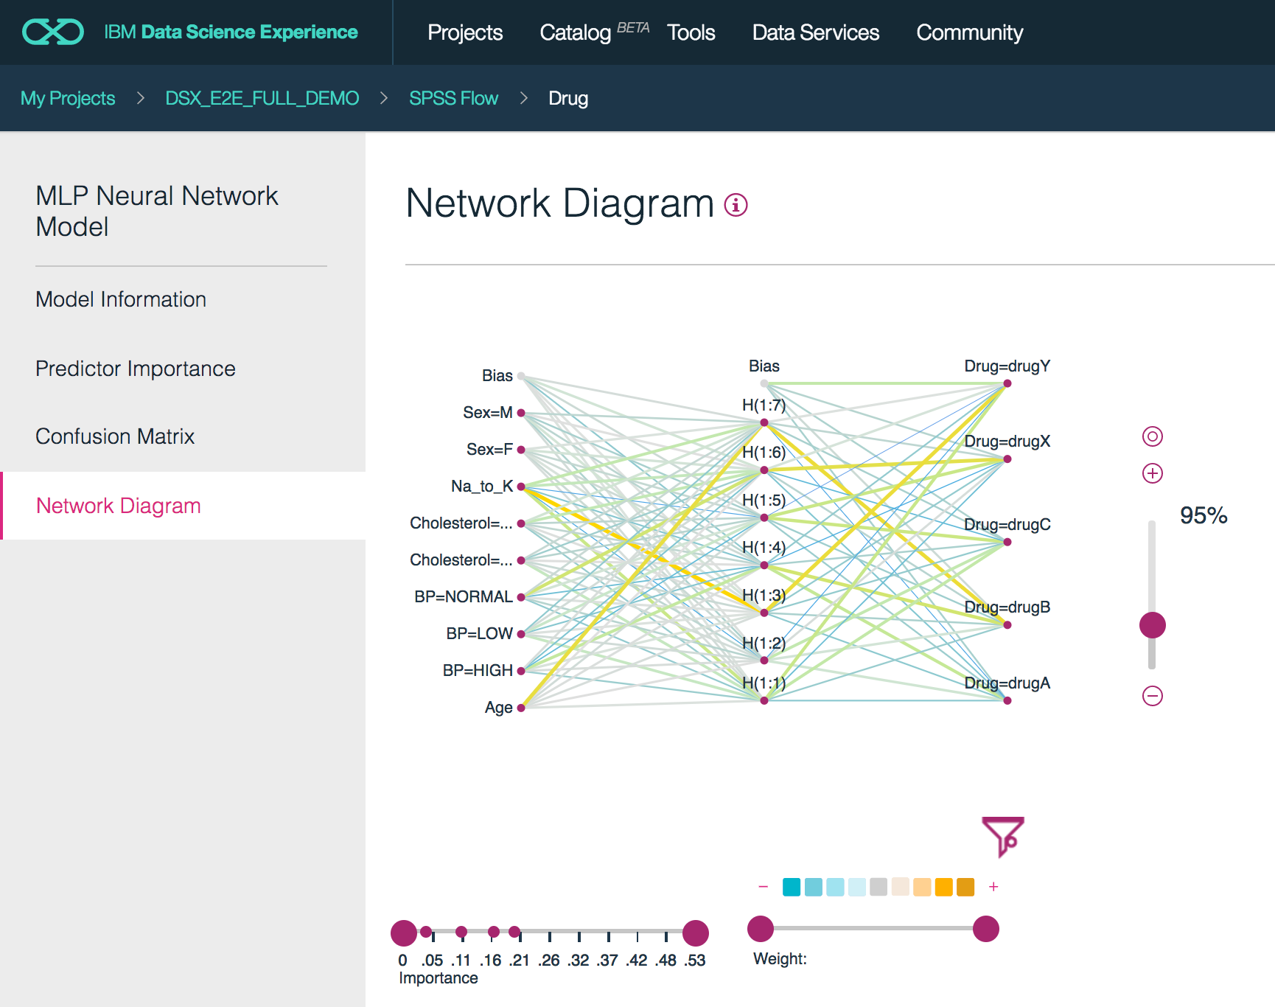
IBM Watson Machine Learning in Data Science Experience
Data Scientist
Open Beta
Flows
Create Advanced Models without coding
Advanced Model Visualization: Easy to understand their performance
Notes:
Now let’s take a look at IBM ML in Data Science Experience.
IBM Machine Learning is provisioned by default in Data Science Experience. It is our deployment fabric that enables Data Scientists to take their models from the lab to production. DSX provides a single UI for creating models, collaborating, deploying, monitoring, and integrating feedback. With a single click, Data Scientists can deploy their machine learning models as web services.
IBM ML is accessible in Data Science Experience via APIs (by coding in Notebooks), Wizard GUI (i.e., called “pipelines” in Projects), and the DSX Canvas (which is a GUI-based approach inspired by SPSS Modeler).
Note: At IBM ML GA in DSX (during 1H 2017) we expect to have both the APIs and Wizard GUI available. The DSX Canvas deployment via IBM ML will GA after the APIs and Wizard.
Also note that DSX Private Cloud will become the standard IDE for IBM ML for z/OS. This is expected to be delivered in 1H 2017.

Slide 16
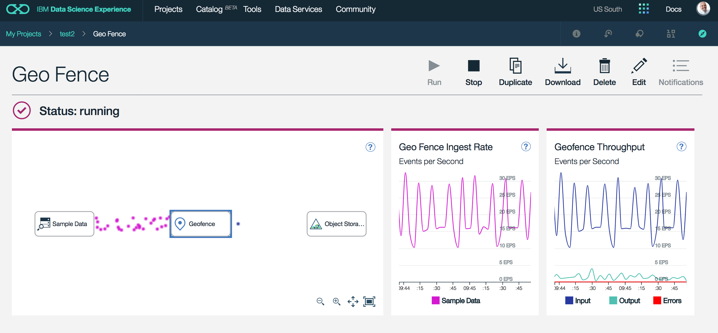
IBM Watson Machine Learning in Data Science Experience
Data Scientist
Open Beta
Streaming Pipelines
Notes:
Now let’s take a look at IBM ML in Data Science Experience.
IBM Machine Learning is provisioned by default in Data Science Experience. It is our deployment fabric that enables Data Scientists to take their models from the lab to production. DSX provides a single UI for creating models, collaborating, deploying, monitoring, and integrating feedback. With a single click, Data Scientists can deploy their machine learning models as web services.
IBM ML is accessible in Data Science Experience via APIs (by coding in Notebooks), Wizard GUI (i.e., called “pipelines” in Projects), and the DSX Canvas (which is a GUI-based approach inspired by SPSS Modeler).
Note: At IBM ML GA in DSX (during 1H 2017) we expect to have both the APIs and Wizard GUI available. The DSX Canvas deployment via IBM ML will GA after the APIs and Wizard.
Also note that DSX Private Cloud will become the standard IDE for IBM ML for z/OS. This is expected to be delivered in 1H 2017.

Slide 18
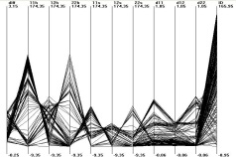






Data centric view of methodology
Data analysis
analytical
statistical
visual
Data ready
Data “pre”-processing
noisy/missing data
data corruption
dim. reduction
Models
Model/pattern evaluation
quantitative
qualitative
Data
Data sources
Data Collection
databases
data warehouses
Hadoop
“Good” model
Model/patterns deployment
prediction
decision support
New data

Slide 19
Preprocessing: Matrix for Machine Learning
Known as:
Attributes
Features
Predictor variables
Explanatory variables
a1 a2 a3 a4 a5 a6 a7 a8 a9 t
Scale variables:
Continuous variables, which can be measured on an interval scale or ratio scale
‘Weight’, ‘Temperature’, ‘Salary’, etc…
Categorical variables:
Data with a limited number of distinct values or categories (nominal or ordinal)
‘Hair color’, ‘Gender’, ‘Grape varieties’, etc…
Known as:
Label
Target variable
Dependent variable
Scale or Categorical

Slide 20
Data pre-processing (preparation)
Data preparation can be very time consuming depending on:
The state of the original data
Data is typically collected in a “human” friendly format
The desired final state of the data (as required by the machine learning models and algorithms)
The desired final state is typically some “algorithm” friendly format
There may be a need for a (long) pipeline of transformations before the data is ready to be consumed by a model:
These transformations can be done manually (write code)
These transformations can be done through tools

Slide 21
Data pre-processing (preparation)
Data can be missing values:
Blank fields
Fields with dummy values (9999)
Fields with “U” or “Unknown”
Data can be corrupt or incoherent:
Data fields can be in the wrong place (strings where numbers are expected)
Spurious “End of Line” characters can chop original lines of data into several lines and cause data fields in the wrong place
Data entered in different formats: USA / US / United States
These aspects of data preparation are often referred to as:
Data cleansing / wrangling

Slide 22
Data pre-processing (preparation)
Data dimensionality may need to be reduced:
The idea behind reducing data dimensionality is that data raw data tends to have two subcomponents:
“Useful features” (aka structure)
Noise (random and irrelevant)
Extracting the structure makes for better models
Examples of applications of dimensionality reduction
Extracting the important features in face/pattern recognition
Removing stop words when working on text classification
Stemming: fishing, fished, fisher ➔ fish
Examples methods of dimensionality reduction
Principal Component Analysis
Singular Value Decomposition

Slide 23
Data pre-processing (preparation)
Data may need to be transformed to match algorithms requirements:
Tokenizing (typical in text processing)
Vectorizing (several algorithms in Spark MLlib require this)
Transform data into Vector arrays
Can be done manually (write Python or Scala code)
Can be done using tools (VectorAssembler in the new ML package)
(TF-IDF in text processing)
Word2Vec
Bucketizing
Transform a range of continuous values into a set of buckets

Slide 24
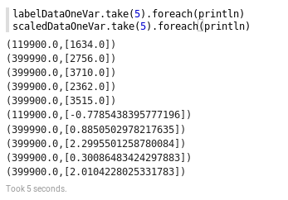
Data pre-processing (preparation)
Data may need to be transformed to match algorithms requirements:
Standardization
Transform data to a set of Vector with Zero mean and Unit Standard deviation
Linear Regression with SGD in Spark MLlib requires this
House
price
Square
footage
House
price
Standardized
Square
footage

Slide 25
Data pre-processing (preparation)
Data may need to be transformed to match algorithms requirements:
Normalization
Transform data so that each Vector has a Unit norm
Categorical values need to be converted to numbers
This is required by Spark MLlib classification trees
Marital Status: {“Widowed”, “Married”, “Divorced”, “Single”}
Marital Status: {0, 1, 2, 3}
You cannot do this if the algorithm could infer: Single = 3 X Married ☺

Slide 26
Data pre-processing (preparation)
Data may need to be transformed to match algorithms requirements:
Dummy encoding
When categorical values cannot be converted to consecutive numbers
Marital Status: {“Single”, “Married”, “Divorced”, “Widowed”}
Marital Status: {“0001”, “0010”, “0100”, “1000”}
This is necessary if the algorithm could make some wrong inference from the numerical based categorical encoding:
Single = 3
Married = 2
Divorced = 1
Widowed = 0
Single = Married + Divorced
Single = Divorced x 3
(this is a contrived example, but you get the idea ☺, replace marital status with colors… )

Slide 27
Data centric view of methodology
Data analysis
analytical
statistical
visual
Data ready
Data “pre”-processing
noisy/missing data
data corruption
dim. reduction
Models
Data
Data sources
Data req/collection
databases
data warehouses
Hadoop

Slide 28
Data analysis:
The data analysis phase is very likely to be intertwined with the data preparation phase:
It is not uncommon to use data analysis results to refine or drive the data preparation
In text classification: Group the tokens at hand and calculate the numbers in each group.
You most likely want to remove the most common and least common tokens as part of the analysis phase.
The data analysis phase should use:
Mathematical tools (Statistics, correlations, Chi Square test of independence, etc…)
Visualizations

Slide 29
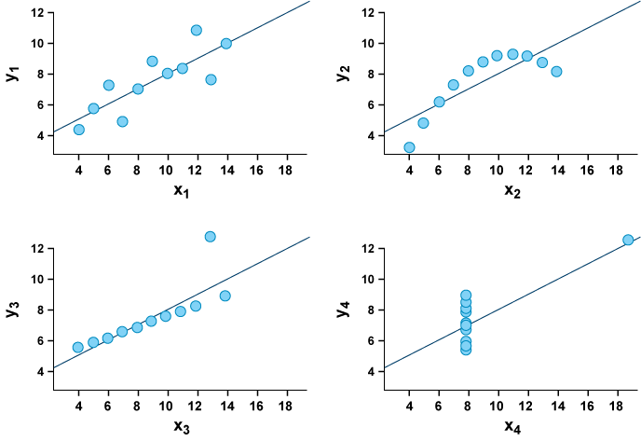
Data analysis: visualizations
The four data sets have similar statistical properties:
The mean of x is 9
The variance of x is 11
The mean of y is approx. 7.50
The variance of y is approx. 4.12
The correlation is 0.816
As shown the linear regression lines are approx. y=3.00+0.500x.
Anscombe’s quartet
The four datasets have nearly identical statistical properties (mean, variance, correlation), yet the differences are striking when looking at the simple visualization

Slide 30
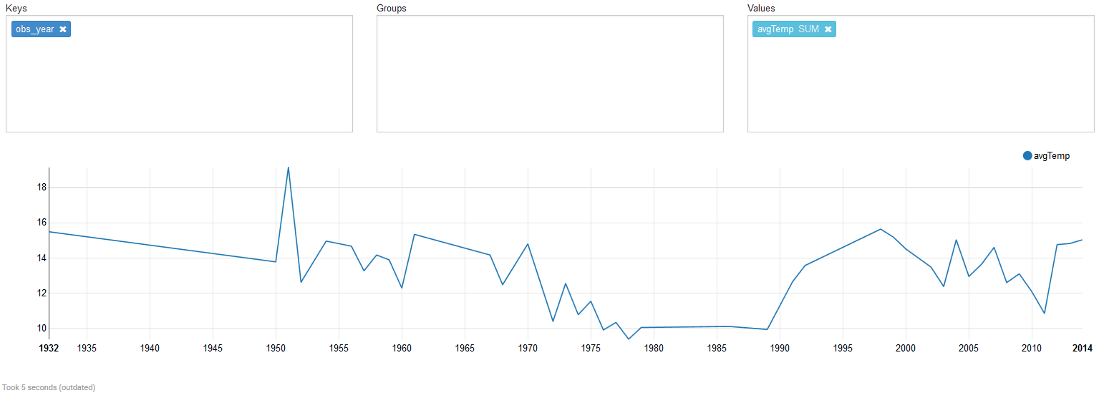
Data analysis: visualizations
Summer surface (depth < 10 meters) average temperature evolution in the archipelago…

Slide 31
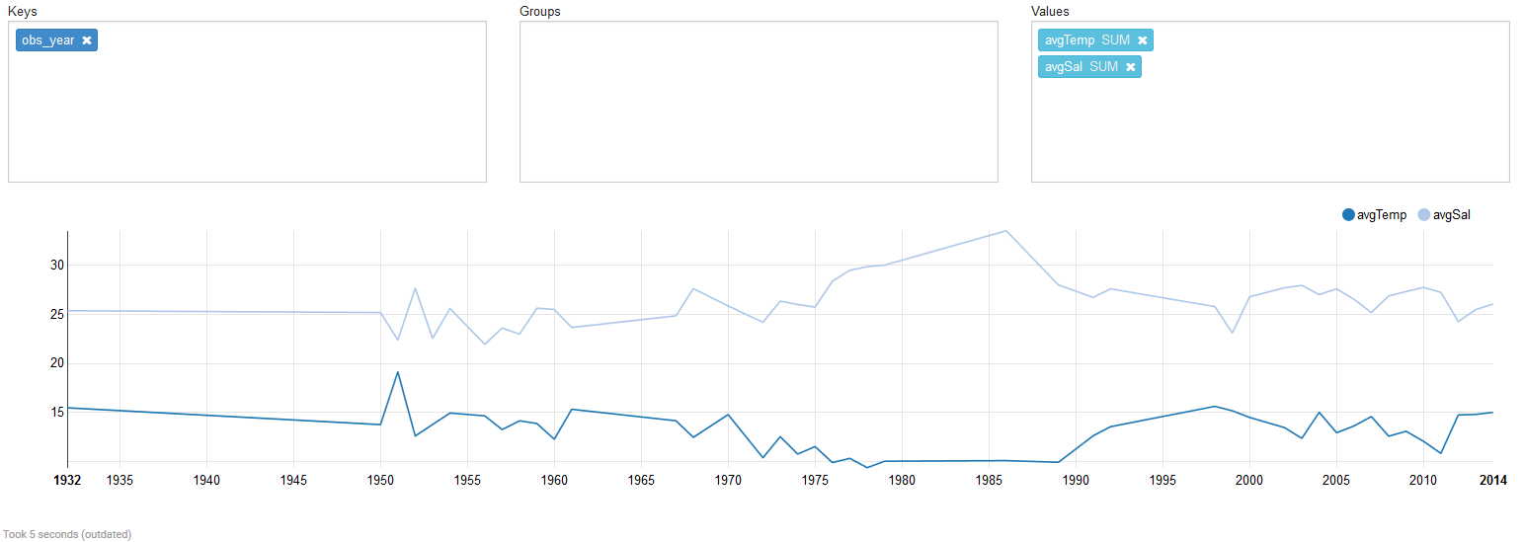
Data analysis: visualizations
Summer surface (depth < 10 meters) average temperature evolution in the archipelago + average salinity…

Slide 32
Data analysis:
The data analysis phase can GUIDE you towards better and more relevant modeling:
When you are building a classifier, it is important to understand the PREVALANCE of the condition that you are building a model for, i.e. how common or uncommon this condition effectively is…
Imagine you are working towards building a classifier for some medical condition and your training and testing data sets yield the following model
Test positive
Test negative
Disease (100)
95 (True Positive) | 5 (False Positive)
5 (False Negative) | 95 (True Negative)
Normal (100)
With 95% sensitivity & specificity, this sounds like a great test…

Slide 33
Data analysis:
What truly matters to the users of your new model / test (doctors, bankers, practitioners) is the PREDICTIVE VALUE of the test:
If the test is positive, then what is the actual chance of being sick?
If the test is positive, then what is the actual chance of defaulting on the loan?
Is it 95% ?
Let’s run the test on a population of 1,000,000 where 1% individuals (10,000) are actually suffering from this condition:
Test positive
Test negative
Disease (10000)
9500 (95% True Positive) | 500 (5% False Negative)
49500 (5% False Positive) | 940500 (95% True Negative)
Normal (990000)

Slide 34
Data analysis:
Test positive
Test negative
Disease (10000)
9500 (95% True Positive) | 500 (5% False Negative)
49500 (5% False Positive) | 940500 (95% True Negative)
Normal (990000)
Probability of being sick if the test is positive:
(# of people truly sick) / # positive result tests
10000 / (49500 + 9500) = 16.9%
What is happening here:
The condition is RARE and the 5% FALSE POSITIVES are still way higher in numbers than the true positives.
Data analysis of the prevalence of the condition tells us that a test with 99% or higher sensitivity / specificity would be needed.

Slide 35
Data centric view of methodology
Data analysis
analytical
statistical
visual
Data ready
Data “pre”-processing
noisy/missing data
data corruption
dim. reduction
Models
Model/pattern evaluation
quantitative
qualitative
Data
Data sources
Data req/collection
databases
data warehouses
Hadoop
“Good” model
Model/patterns deployment
prediction
decision support
New data

Slide 36
Data Science Methodology
Business understanding
Analytic approach
Feedback
Data requirements
Deployment
Data collection
Data Scientist/ Data Engineer
Statistician
Domain Expert
Evaluation
Data understanding
Modeling
Data preparation

Slide 37

Machine Learning – A more formal definition
Tom Mitchell of Carnegie Mellon University provides a widely quoted, more formal definition of machine learning
"A computer program is said to learn from experience E with respect to some class of tasks T and performance measure P if its performance at tasks in T, as measured by P, improves with experience E"

Slide 38
Machine Learning vs Human Learning
In many aspects, ML not fundamentally different from HL:
Repeat the same task over and over again to gain experience.
Action of repeating the same task is referred to as “practice”
With practice and experience, we get better at learned tasks.
Examples:
Learning how to play a music instrument
Learning how to play a sport (golf, tennis, etc…)
Practicing for a math exams doing exercises
A teacher or coach will measure performance to evaluate progress
Practice makes perfect

Slide 39
Learning challenges
Under fitting:
Not knowing enough “basic” concepts, i.e. not being well-equipped enough to tackle learning at hand:
You can’t study calculus without knowing some algebra.
You can’t learn playing hockey without knowing how to skate.
You can’t learn polo without knowing how to ride.
This can lead to under fitting in Machine Learning: The chosen model is just not “sophisticated”, “rich”, enough to capture the concept.
aX + BY + C

Slide 40
Learning challenges
Over fitting:
Hyper-sensitivity to minor fluctuations, ending up in modeling a lot of the unwanted noise in the data:
This can lead to over fitting in Machine Learning.

Slide 41
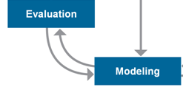
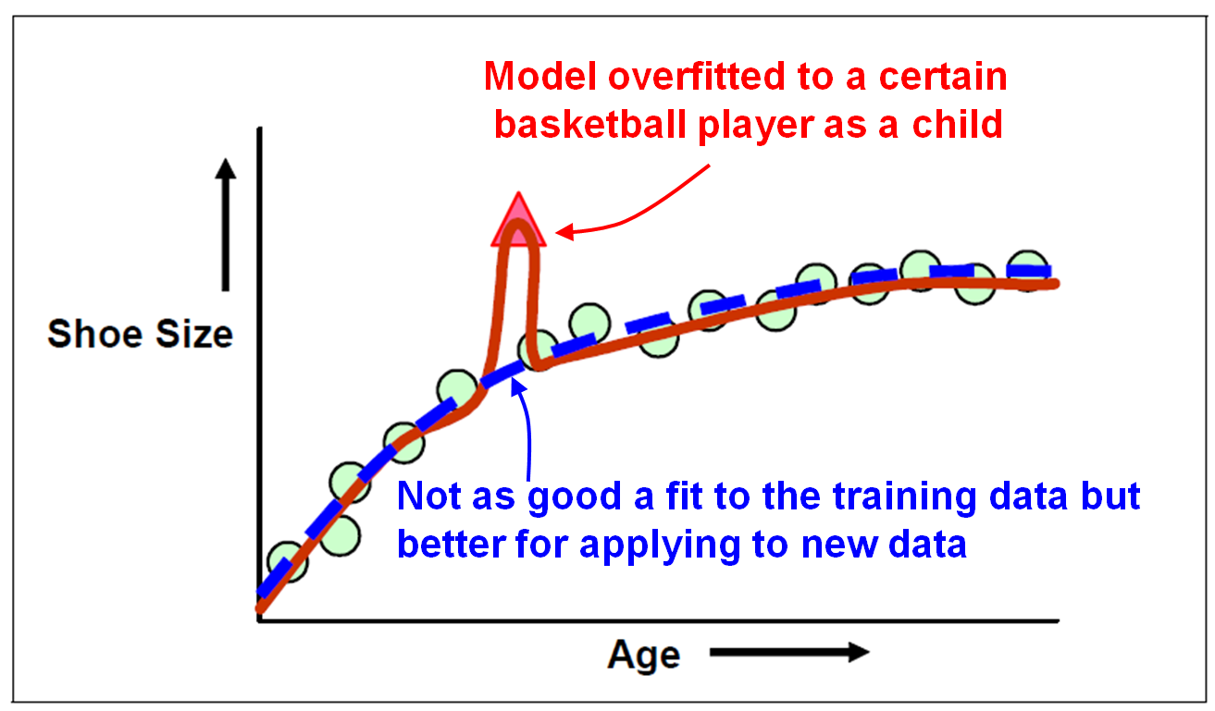
Model overfitting
When building a predictive model, there is a risk of overfitting the model to the training data.
The model fits the training data very well, but it does not perform well when applied to new data.

Slide 42
Learning challenges
Compromise between bias and variance:
Prediction
Error
Variance (over fitting)
Bias (under fitting)
Overly
simple
model
Good
model
Over-
fitted
model
Complexity of the model

Slide 43
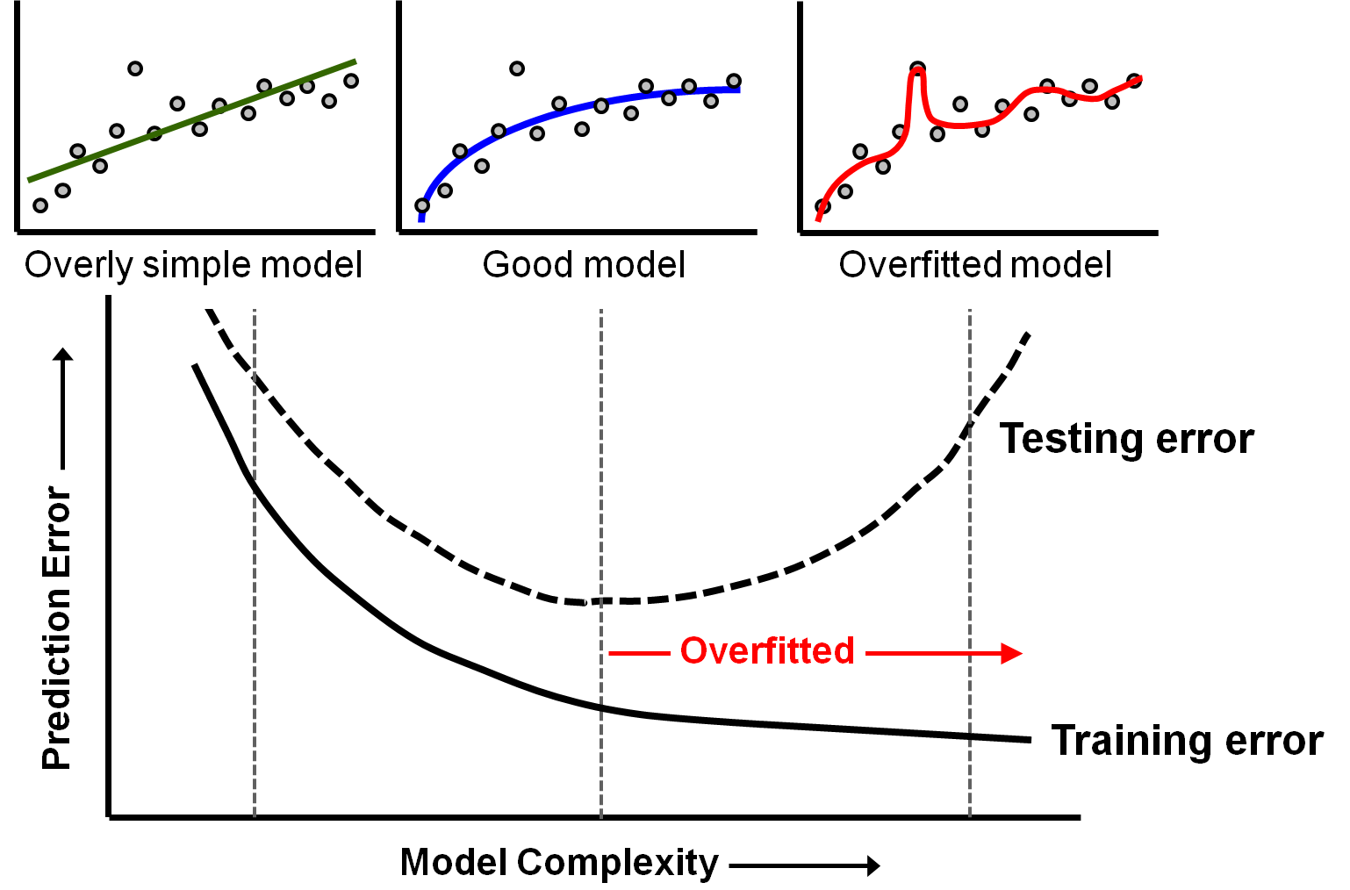
When to stop training a model

Slide 44
Learning challenges
Diminishing returns:
People can:
Have more or less talent
get bored or enthusiastic
Machines will not, however:
Making progress initially is usually more easy, but improving gets harder as we move along. We may need to try different learning methods, styles to keep going:
Machine learning algorithms have hyper-parameters which need to be tuned properly.
It may be necessary to use more than just one single method / algorithm to reach the goal.

Slide 45
Machine Learning Examples
Is this cancer ? (Medical diagnosis)
Is this legitimate or fraud (spam) ?
What is the market value of this house ?
Which of these people are good friends with each other ?
Will this engine fail (when) ?
Will this person like this movie ?
Who is this ?
What did you say ? (Speech recognition)
Machine Learning solves problems that cannot be tackled by numerical means alone.

Slide 46
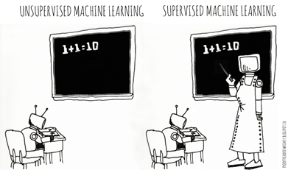
Categories of Machine Learning
Supervised learning
The program is “trained” on a pre-defined set of “training examples”, which then facilitate its ability to reach an accurate conclusion when given new data
The algorithm is presented with example inputs and their desired outputs (correct results)
The goal is to learn a general rule that maps inputs to outputs
Unsupervised learning
No labels are given to the learning algorithm, leaving it on its own to find structure (patterns and relationships) in its input
Unsupervised learning can be a goal in itself (discovering hidden patterns in data) or a means towards an end (feature learning)

Slide 47
Categories of Machine Learning
 | Discrete Output | Continuous Output
Supervised Learning (require Ground-Truth) | Classification (outcome is discrete) Binary Classification Linear Models (Logistic Regression) Decision Trees Naïve Bayes Multi class Classification Decision Trees Naïve Bayes K-NN | Regression - Linear Ridge Lasso Decision Trees Random Forest Gradient Boosted Trees
Unsupervised Learning (no Ground-Truth data required) | Clustering - k-means FP-Growth | Clustering - k-means - Gaussian Mixture Dimensionality Reduction - PCA - SVD

Slide 48
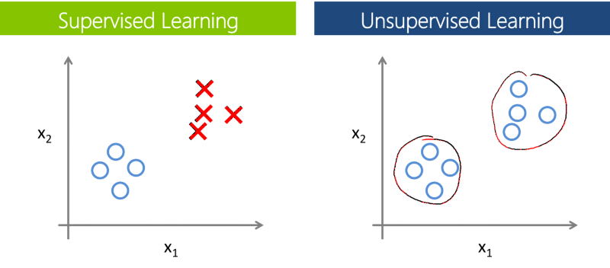
Supervised vs. Unsupervised Learning

Slide 49
Classification – Decision tree
Class variable (target) with two or more outcomes.
Splits records in a tree-like series of nodes along mutually-exclusive paths.
Algorithm decides which variable and threshold value to use at each split
New records are predicted (classified) based on the leaf assignment
Accurate
Explicit decision paths
Can also handle continuous target (“regression tree”).
Days Since Previous Visit <= 225
No
Yes
Readmit = No
Visits to Doctor in Past Year <= 3
No
Yes
10% of patients are readmitted.
Patient Age <= 61
Etc.
No
Yes
Etc.
Readmit = Yes
92% of patients are readmitted.

Slide 50
Classification – Naïve Bayes
Two or more outcomes.
Assumes independence among explanatory variables, which is rarely true (thus “naïve”).
Despite its simplicity, often performs very well… widely used.
Significant use cases:
Text categorization (spam vs. legitimate, sports or politics, etc.) using word frequencies as the features
Medical diagnosis (e.g., automatic screening)

Slide 51
Classification – Naïve Bayes
Outlook | Temp | Humidity | Windy | Play golf
Sunny | Hot | High | False | No
Sunny | Hot | High | True | No
Overcast | Hot | High | False | Yes
Rainy | Mild | High | False | Yes
Rainy | Cool | Normal | False | Yes
Rainy | cool | Normal | True | No
Overcast | Cool | Normal | True | Yes
Sunny | Mild | High | False | No
Sunny | Cool | Normal | False | Yes
Rainy | Mild | Normal | False | Yes
Sunny | Mild | Normal | True | Yes
Overcast | Mild | High | True | Yes
Overcast | Hot | Normal | False | Yes
Rainy | Mild | High | True | No

Slide 52
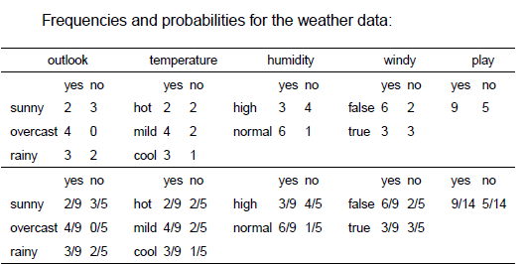
Classification – Naïve Bayes

Slide 53
Classification – Naïve Bayes
L(yes) = 2/9 * 3/9 * 3/9 * 3/9 = 0.0082
L(no) = 3/5 * 1/5 * 4/5 * 3/5 = 0.0577
P(yes) = 0.0082 * 9/14 = 0.0053
P(no) = 0.0577 * 5/14 = 0.0206
The decision would be: NO.

Slide 54
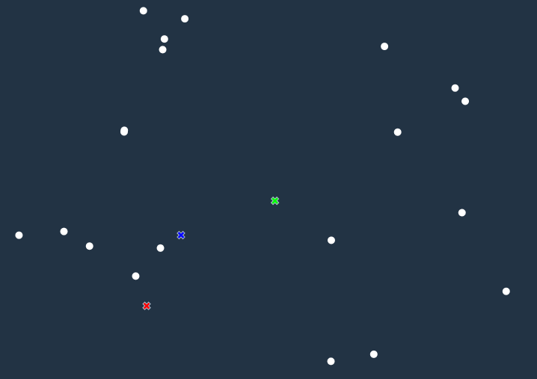
Clustering – K-means method
Start with 20 data points and 3 clusters

Slide 55
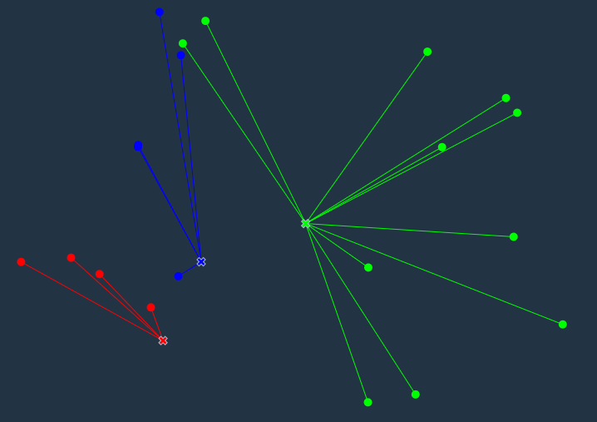
Clustering – K-means method
Assign each data point to the nearest cluster

Slide 56
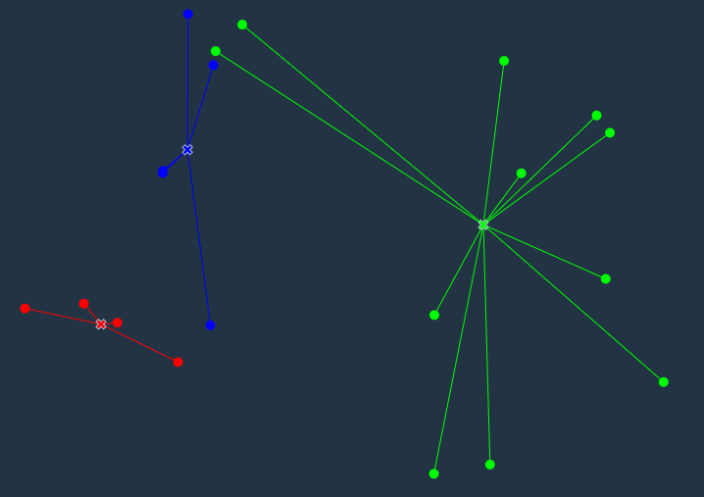
Clustering – K-means method
Calculate centroids of new clusters

Slide 57
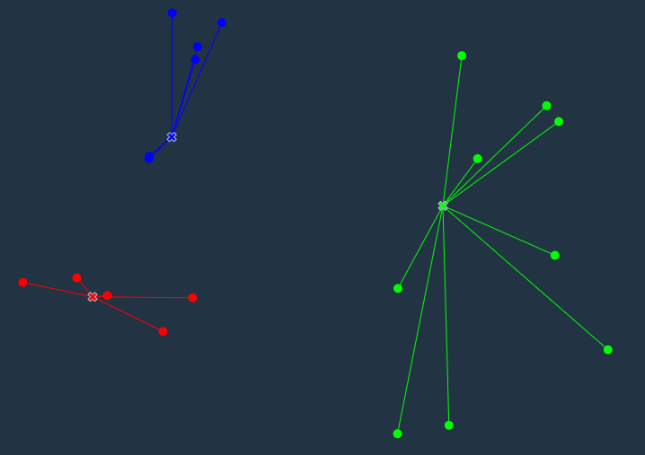
Clustering – K-means method
Assign each data point to the nearest cluster

Slide 58
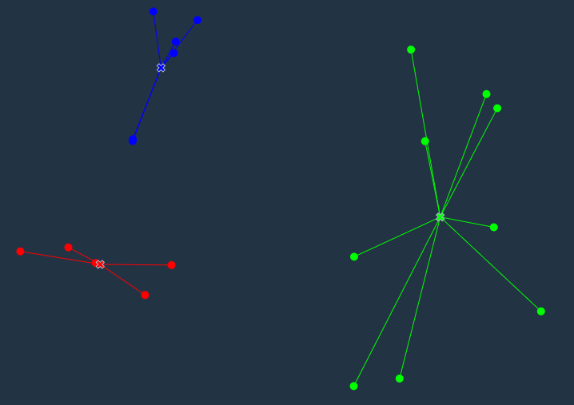
Clustering – K-means method
Calculate centroids of new clusters…until convergence

Slide 59
Training, testing, & validation sets
During the model development process, supervised learning techniques employ training and testing sets and sometimes a validation set.
Historical data with known outcome (target, class, response, or dependent variable)
Source data randomly split or sampled… mutually exclusive records
Why?
Training set ➔ build the model (iterative)
Testing set ➔ tune the parameters & variables during model building (iterative)
Assess model quality during training process
Avoid overfitting the model to the training set
Validation set ➔ estimate accuracy or error rate of model (once)
Assess model’s expected performance when applied to new data

